Slide 1
An Orbit Around the Life of Galileo Galilei
LADC Presentation by
Krishnaraj, Devanshu, Parth, Pranaav, Tirth and Pranav

Slide 2
Contents
Early Life (1 min)
His Education and Interests (2 mins)
Making of the Telescope(3 Mins)
Astronomical Discoveries(3 Mins)
Mathematical Contributions(4 Mins)
Interesting Facts and Conclusion (3 Mins)

Slide 3
Early Life
Introduction
Birth Place, era
Family Background
Who he was
Why he was famous in 1 line
[13:56, 2/3/2022] 71. Pranav Walvekar: intro Galileo was a natural philosopher, astronomer, and mathematician who made fundamental contributions to the sciences of motion, astronomy, and strength of materials and to the development of the scientific method. He also made revolutionary telescopic discoveries, including the four largest moons of Jupiter.[13:56, 2/3/2022] 71. Pranav Walvekar: birth place - PISA, ITALY[13:57, 2/3/2022] 71. Pranav Walvekar: Family Background - . His father, Vincenzo Galilei, was a musician. Galileo's mother was Giulia degli Ammannati. Galileo was the first of six (though some people believe seven) children.[13:57, 2/3/2022] 71. Pranav Walvekar: who he was - Galileo was a natural philosopher, astronomer, and mathematician who made fundamental contributions to the sciences of motion, astronomy, and strength of materials and to the development of the scientific method.[13:58, 2/3/2022] 71. Pranav Walvekar: why was he famous - Galileo was a natural philosopher, astronomer, and mathematician who made fundamental contributions to the sciences of motion, astronomy, and strength of materials and to the development of the scientific method. he became famous In 1583 when he made his first important discovery, describing the rules that govern the motion of pendulums

Slide 4
Education and Developing Interests
Where he studied
How he studied
Why the interest in science
Mentors if any
University Life upto 20s
Galileo Galilei was educated at the Camaldolese Monastery at Vallombrosa. In 1581 he was sent by his father to enrol for a medical degree at the University of Pisa. Galileo never seems to have taken medical studies seriously, attending courses on his real interests which were in mathematics and natural philosophy. He left Pisa in 1585 without completing his medical degree and began teaching mathematics in Florence and later at Siena. During the summer of 1586 he taught at Vallombrosa, and in this year he wrote his first scientific book The little balance (La Balancitta) which described Archimedes' method of finding the specific gravities of substances using a balance.
He was influenced by the lectures of Girolamo Borro and Francesco Buonamici of Florence. In 1581, when he was studying medicine, he noticed a swinging chandelier, which air currents shifted about to swing in larger and smaller arcs. To him, it seemed, by comparison with his heartbeat, that the chandelier took the same amount of time to swing back and forth, no matter how far it was swinging. When he returned home, he set up two pendulums of equal length and swung one with a large sweep and the other with a small sweep and found that they kept time together. It was not until the work of Christiaan Huygens, almost one hundred years later, that the tautochrone nature of a swinging pendulum was used to create an accurate timepiece. Up to this point, Galileo had deliberately been kept away from mathematics, since a physician earned a higher income than a mathematician. However, after accidentally attending a lecture on geometry, he talked his reluctant father into letting him study mathematics and natural philosophy instead of medicine.

Slide 5
Making of the Telescope
The Need to make the Telescope
The Desperation
Necessity is the mother of Invention
Story of the Emperor and Telescope, Job and stuff.
Impact of the Telescope on Science. Prolly a flowchart or sth. Make like a simple flowchart thingy, but like the things that the flowchart leads to are slides that you can click on and navigate to.

Slide 6
Astronomical Discoveries
Stuff he saw through the Telescope
What impact that had on him
What impact that had on the people around him, how they reacted, how the church reacted.
His Diagrams and stuff, the things he calculated from his observations.
Any other event, story, discovery or anything related to this topic (if exists)

Slide 7
Astronomical Discoveries
~ Parth Zarekar

Slide 8
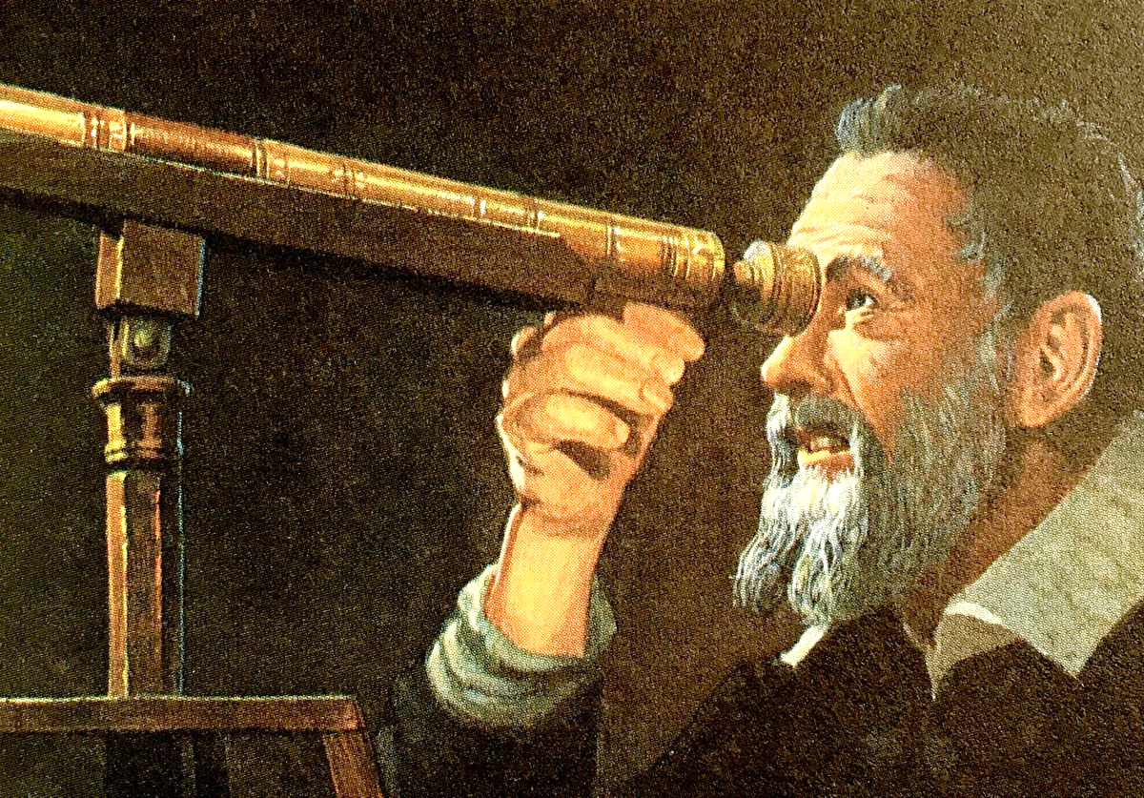
Discoveries he made through telescope. ( you can change this title)

Slide 9
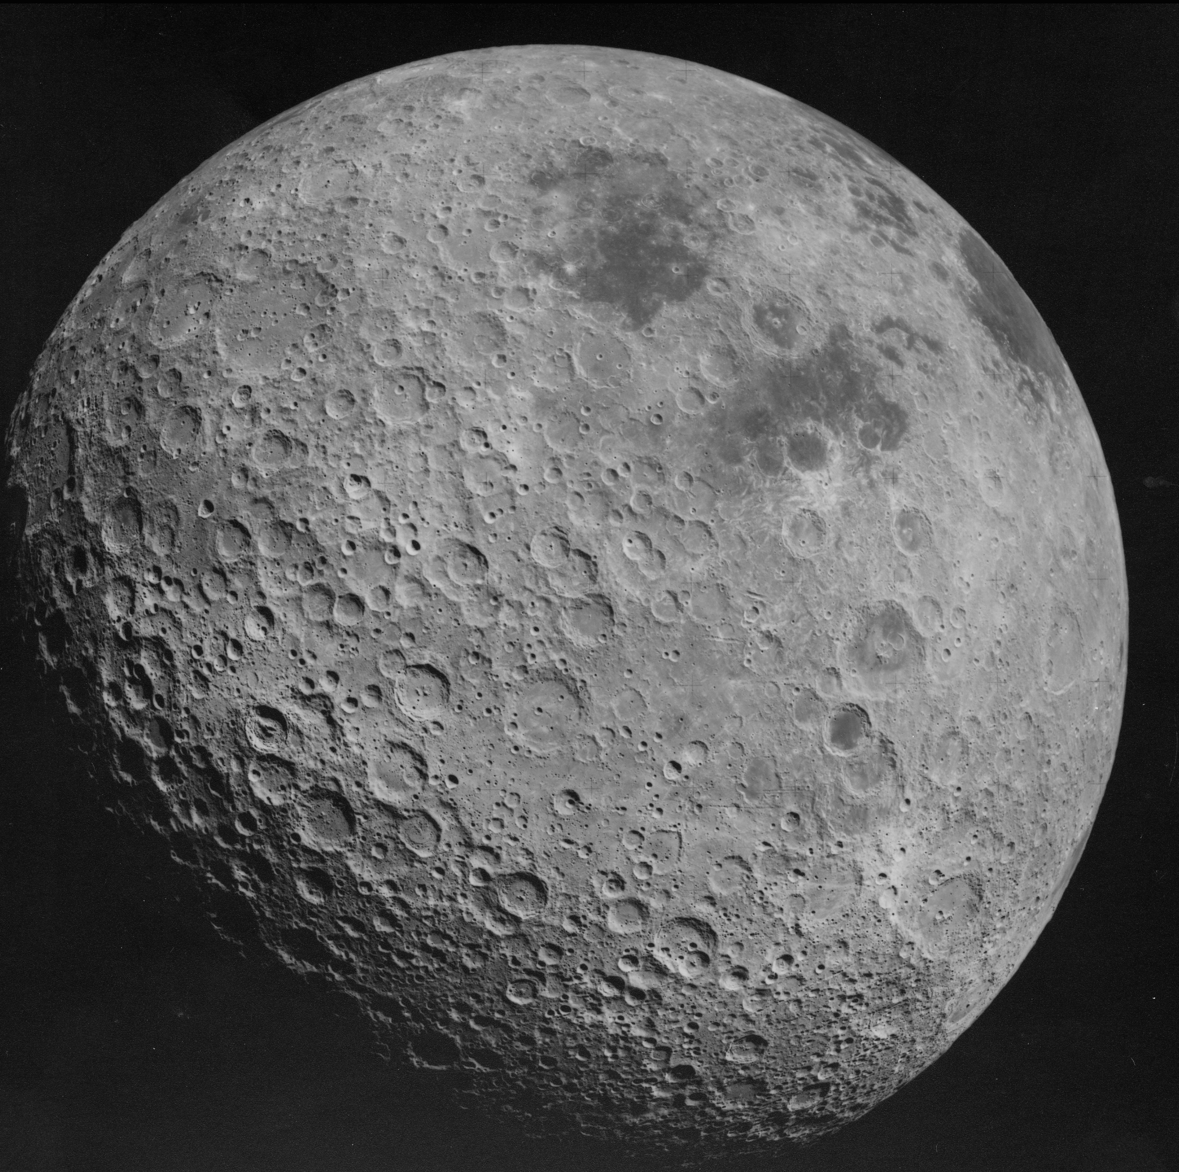
Things he Observed on the moon.
Mountains
Craters
Lunar Mountains

Slide 10
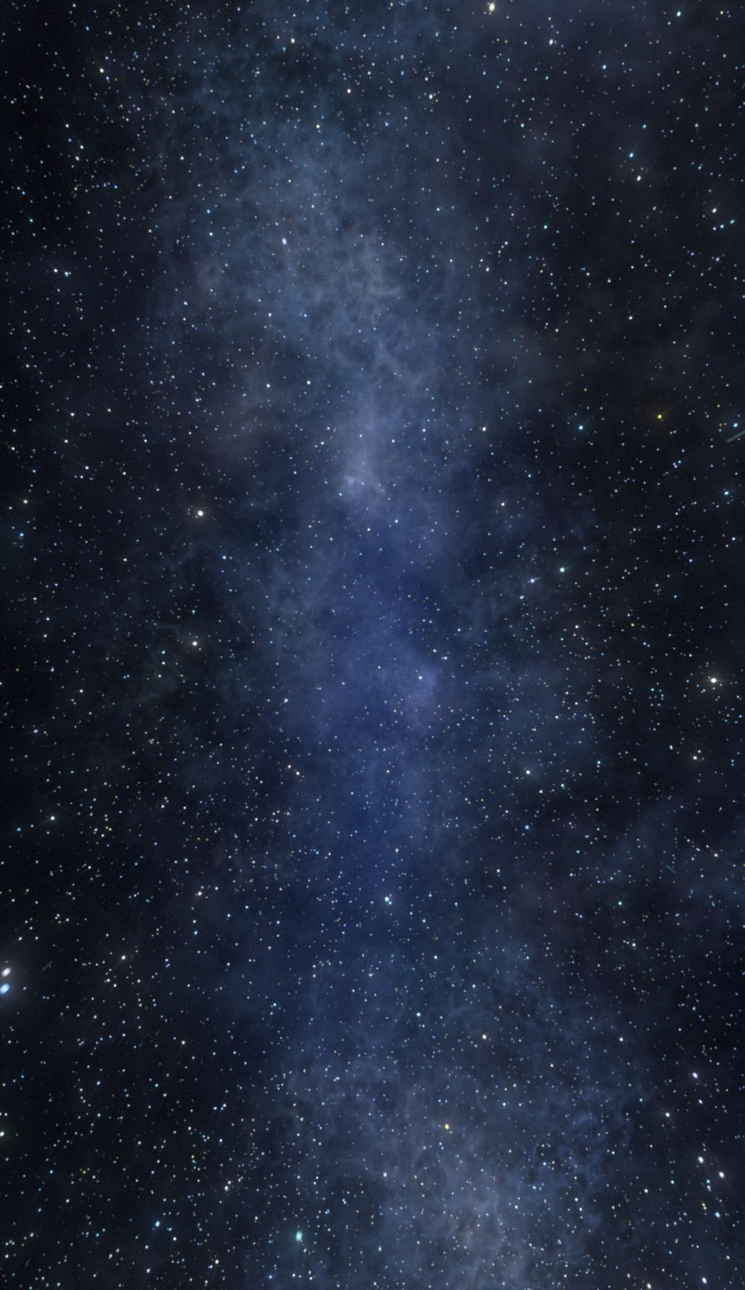
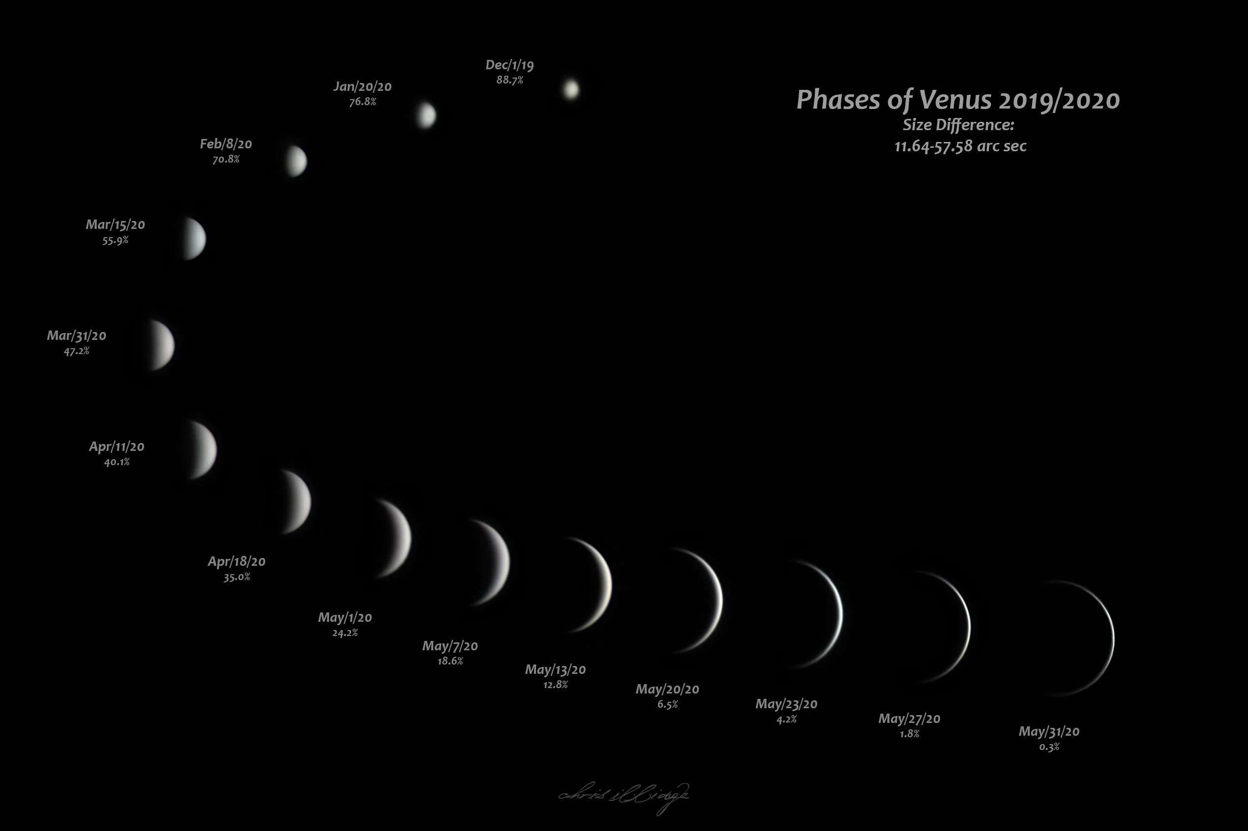
Phases Of Venus

Slide 11
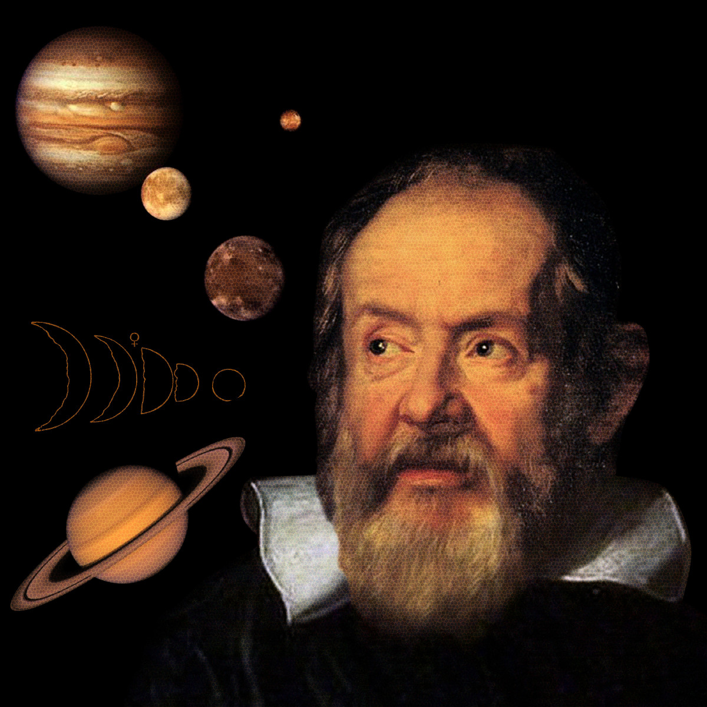
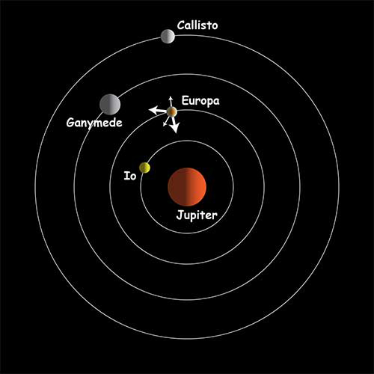
Discovery of Jupiter and its moon’s.

Slide 12
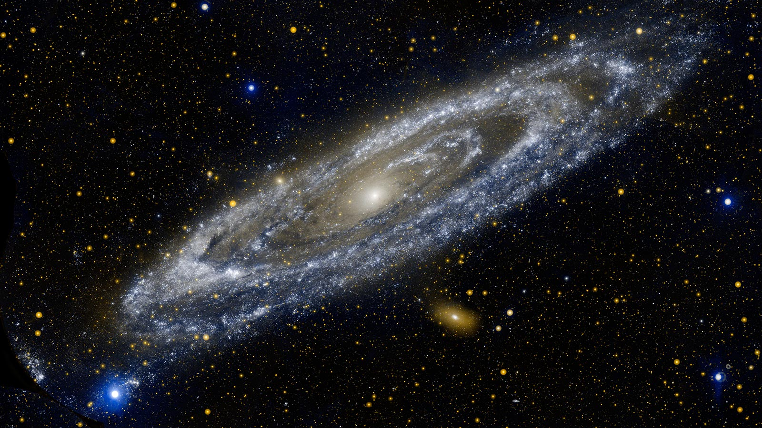
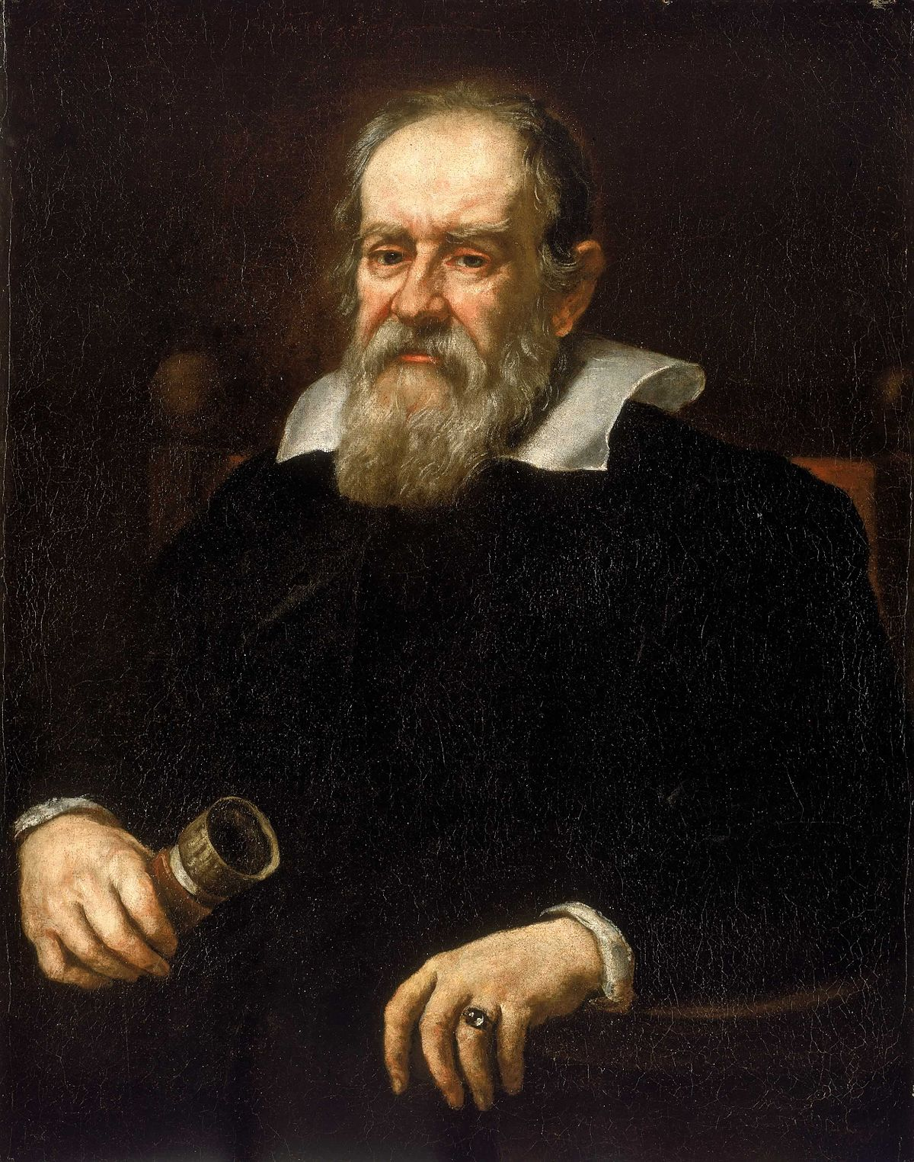

Slide 13
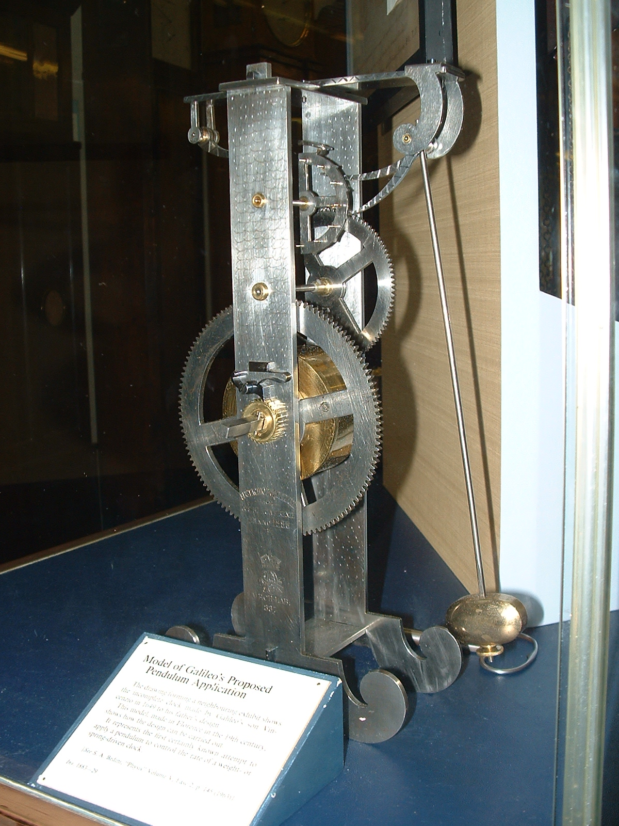
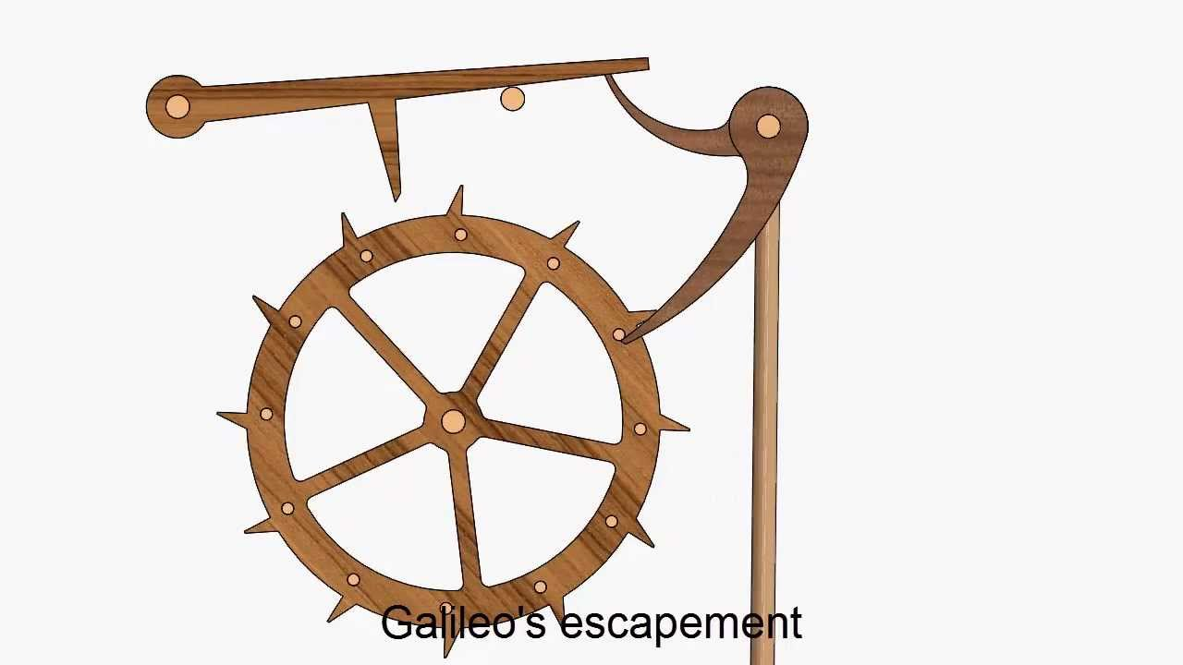

Slide 14
Mathematical Discoveries
Discovering that Pendulums are isochronous, and the experiments and proofs that followed that discovery
Mapping Venus’s Phases and providing proof to the Heliocentric Copernican Model. Maybe some calculations from there.
mathematics is the language of science and the only means to achieve lasting truth in physics. Is something he said, and is considered the father of modern science. (so prolly talk about that)
He stated the basic Principle of Relativity. Maybe some basic equations from his book can be shown, or maybe the statement, and then the equations from Einstein’s General Theory of Relativity can be shown.
Brachistochrone Problem, Infinite Sets, Galileo’s Paradox, Proving the Path of a projectile is parabolic (this will have some equations as well)

Slide 15

alileos clock which works on principle of pendulum .
The formula for the period T of a pendulum is T = 2π Square root of√^{L}/_{g}, where L is the length of the pendulum and g is the acceleration due to gravity.

Slide 16
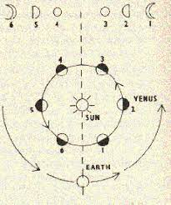
galileo mapping of venus phases
Galileo Galilei's observations that Venus appeared in phases -- similar to those of Earth's Moon -- in our sky was evidence that Venus orbited the sun and contributed to the downfall of the centuries-old belief that the sun and planets revolved around Earth.

Slide 17
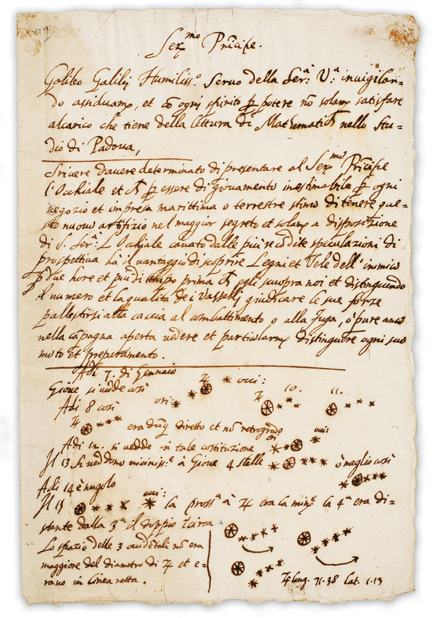
Galileo's principle of relativity states "It is impossible by mechanical means to say whether we are moving or staying at rest". If two trains are moving at the same speed in the same direction, then a passenger in either train will not be able to notice that either train is moving

Slide 18
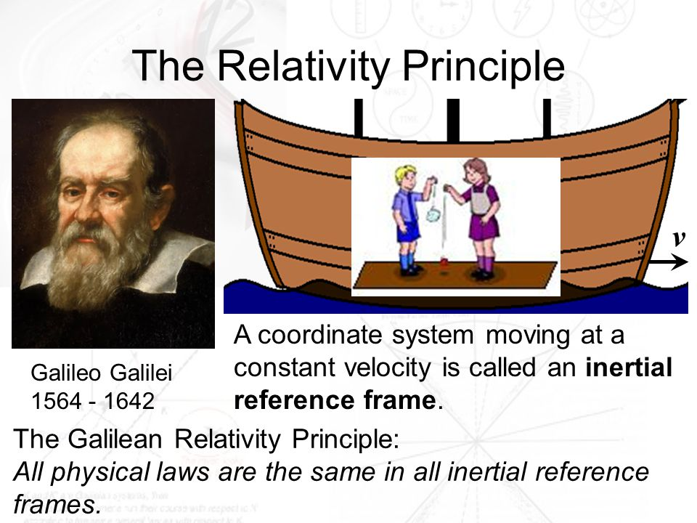

Slide 19
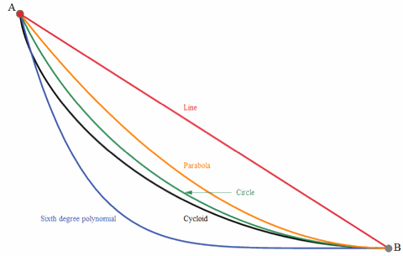

Slide 20
Brachistochrone Problem: Which path from A to B is traversed in the shortest time? (Click image to animate.) This is the Brachistochrone (“Shortest Time”) Problem. ... Galileo studied motion under gravity, showing that a body falling in space traverses a distance proportional to the square of the time of descent.

Slide 21
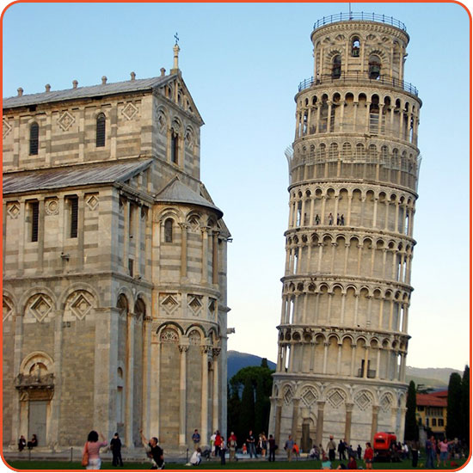
Interesting Facts
GALILEO GALILEI PROBABLY NEVER DROPPED ANYTHING OFF THE LEANING TOWER OF PISA.
With its convenient “tilt,” the famous tower in Pisa, where Galileo spent the early part of his career, would have been the perfect place to test his theories of motion, and of falling bodies in particular.

Slide 29
Our Team
Pranav – Early Life and Introduction
Devanshu – Education and Interests
Krishnaraj – Presentation and Inventions
Parth – Astronomical Discoveries and Math
Tirth – Mathematical Contributions
Pranaav – Interesting Facts and Conclusion

Slide 30
Thanks

